Slide 1



深度學習 Deep Learning
Transformers
自注意力機制模型
Instructor: 林英嘉 (Ying-Jia Lin)
2025/04/07
Course GitHub
Slido # DL_0407

Slide 2
Outline
Weakness of RNNs and CNNs [10 min]
Transformers [60 min]
Vision Transformer [20 min]
Announcement about Midterm Exam [15 min]
Project introduction [30 min]
Quiz [15 min]

Slide 3
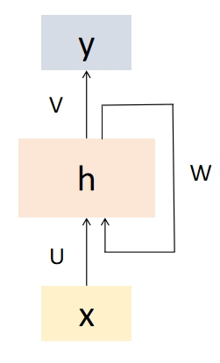
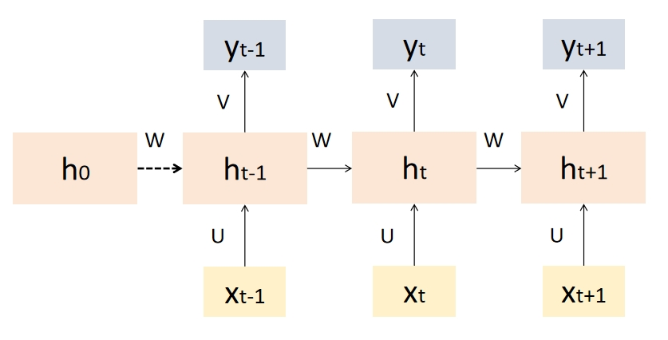
[Recap] Recurrent Neural Networks (RNN)
Recurrent Neural Networks (RNNs) are a type of artificial neural network designed to handle sequential data by capturing temporal dependencies.
RNN 的“遞迴”是指它在每一個時間步中重複使用相同的參數（同一組權重），並把先前的隱藏狀態傳到下一個時間步

Slide 4
[Recap] Text Generation with RNN
Hidden size: 100
Vocab
Prob
a
...
apple
...
b
...
banana
...
elephant
...
eraser
...
...
zoo
0.0001
...
0.600
...
0.0001
...
0.0003
...
0.300
...
0.05
...
...
0.0001
$$h$$
Classification Layer
Hidden size: Vocab_size
RNN
RNN
RNN
$$h′$$
Vocab
size
I
love
an

Slide 5
RNN code example
class RNNModel(torch.nn.Module): def __init__(self, vocab_size=30000, embed_dim=300, hidden_dim=300):
super().__init__()
self.vocab_size = vocab_size
self.hidden_dim = hidden_dim
self.embedding_layer = torch.nn.Embedding(vocab_size, embed_dim)
self.rnn = torch.nn.RNN(embed_dim, hidden_dim)
self.fc = torch.nn.Linear(hidden_dim, 2)
def forward(self, X): E = self.embedding_layer(X)
H_out, H_n = self.rnn(E) logits = self.fc(H_out[:, -1, :])
return logits
把每個字都轉成長度為 embed_dim 的向量
RNN接受長度為 embed_dim 的向量
每個時間點產生長度為 hidden_dim 的隱藏狀態 (hidden state)
H_out‘s shape: BS x seq_len x hidden_dim

Slide 6
Tokens vs. words
token 是 (語言) 模型在每個時間點處理的單位
word 是語言本身的單位
token 可以是 word，也可以是 sub-word
一個 word 可以是一個 token，但單純講 token 不一定指的是 word
Traditional word tokenization
Sub-word Tokenization
I
printed
Hello
world
I
prin
ted
Hell
o
world

Slide 7

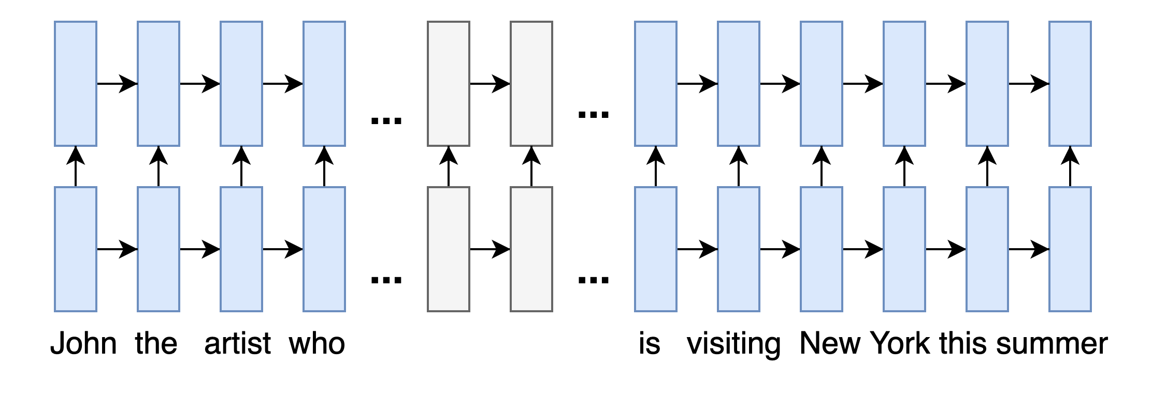
Issues with RNNs: Linear Interaction Distance
In RNNs, the degree of words interact with each other is decided by their distance, but we already know that linear importance is not the right way to understand a sentence...
▷ But the RNN may fail to identify New York as the correct answer since the info of "John" has been propagated for almost O(N) (N: sequence length).
{
O(N)
Notes:
https://web.stanford.edu/class/cs224n/slides/cs224n-2021-lecture09-transformers.pdf
https://drive.google.com/file/d/1zMGuiJLn0CBjiOYnUn3MG29nMtVpttM7/view?usp=sharing
例子：自己想的（inspired by Stanford course slides）
圖：自己畫的，可以改上面

Slide 8
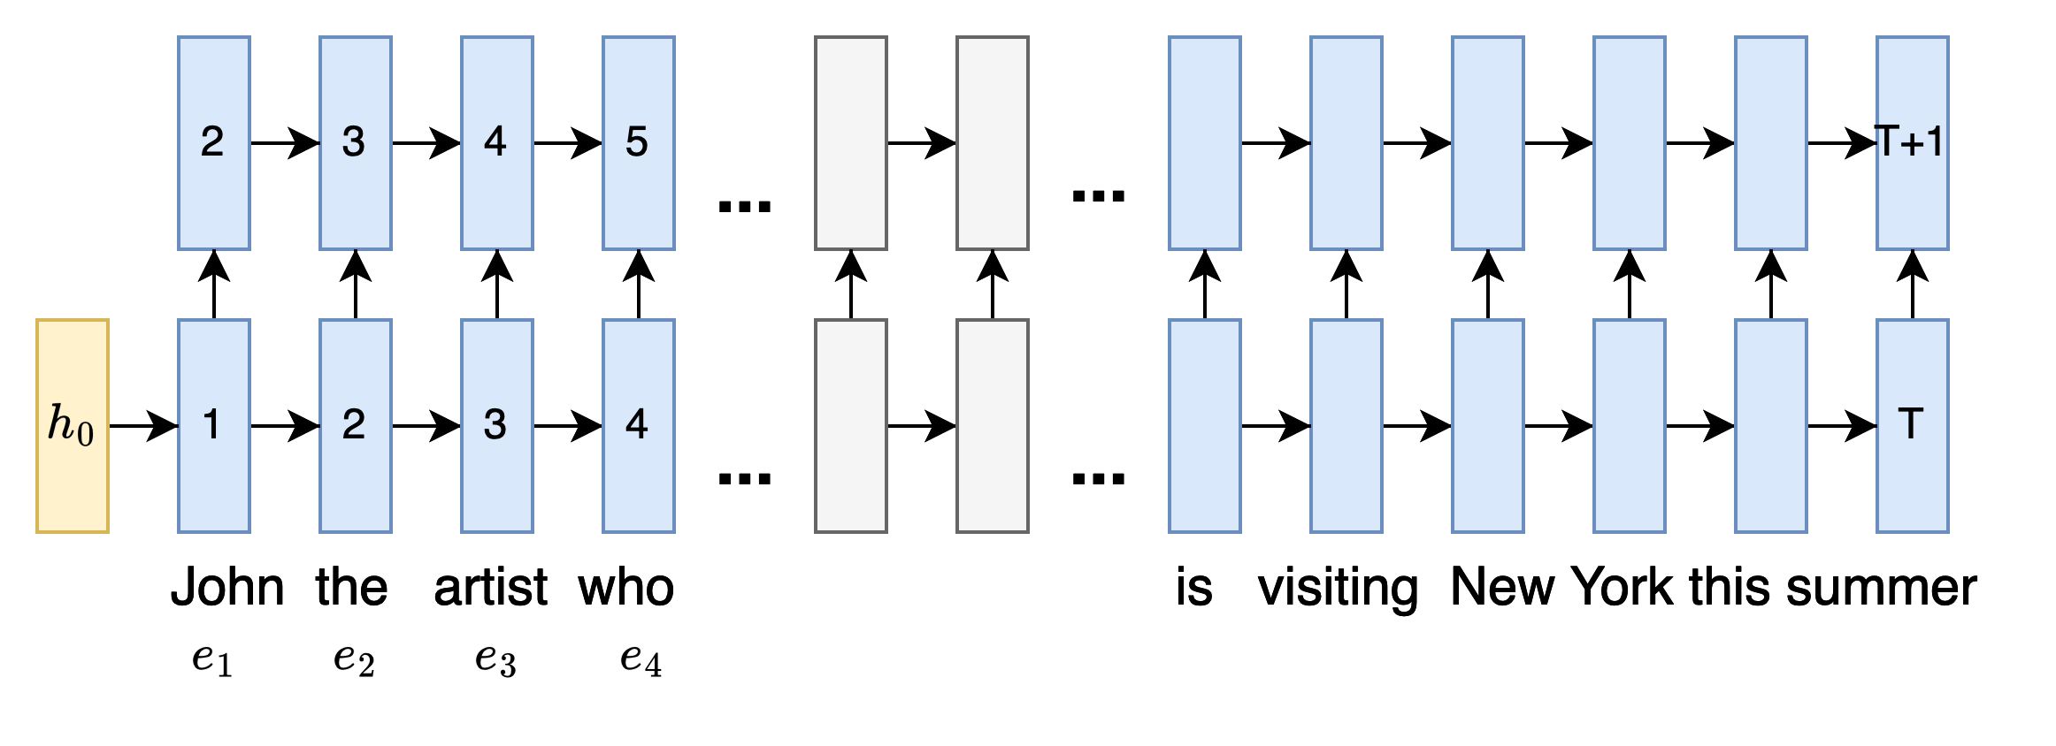
Issues with RNNs: No Parallelizability
Past hidden states need to be fully computed before the next hidden state to be ready for computation, which means it is unparallelizable between each timestep. This prevents RNN’s use on large corpus or long text.
Layer 2
Layer 1
Embedding
△ This is a 2-layer, uni-directional RNN. Each blue rectangle is a hidden state at the time-step of the layer. The number indicates the min # of steps required for the hidden state to be computed.
Notes:
https://drive.google.com/file/d/1zMGuiJLn0CBjiOYnUn3MG29nMtVpttM7/view?usp=sharing
例子：自己想的（inspired by Stanford course slides）
圖：自己畫的，可以改上面

Slide 9


Issues with CNNs: long-term dependencies
Padding = 0, stride = 1
Padding = 0, stride = 2
Figure source: https://hannibunny.github.io/mlbook/neuralnetworks/convolutionDemos.html

Slide 10
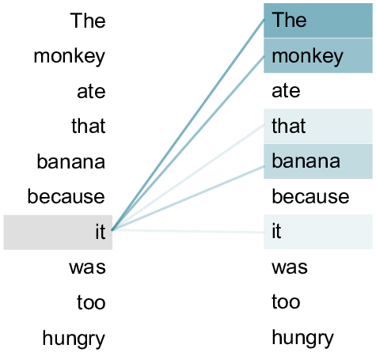
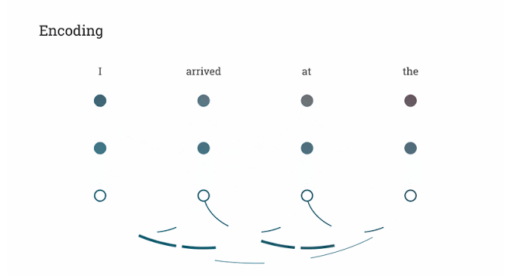
Transformers
Source: An example of the self-attention mechanism following long-distance... | Download Scientific Diagram (researchgate.net)
Attention Is All You Need (Vaswani et al., NeurIPS 2017)
Self-attention
: 句子內的每個 token 自己跟自己做attention
Figure source: https://research.google/blog/transformer-a-novel-neural-network-architecture-for-language-understanding/

Slide 11
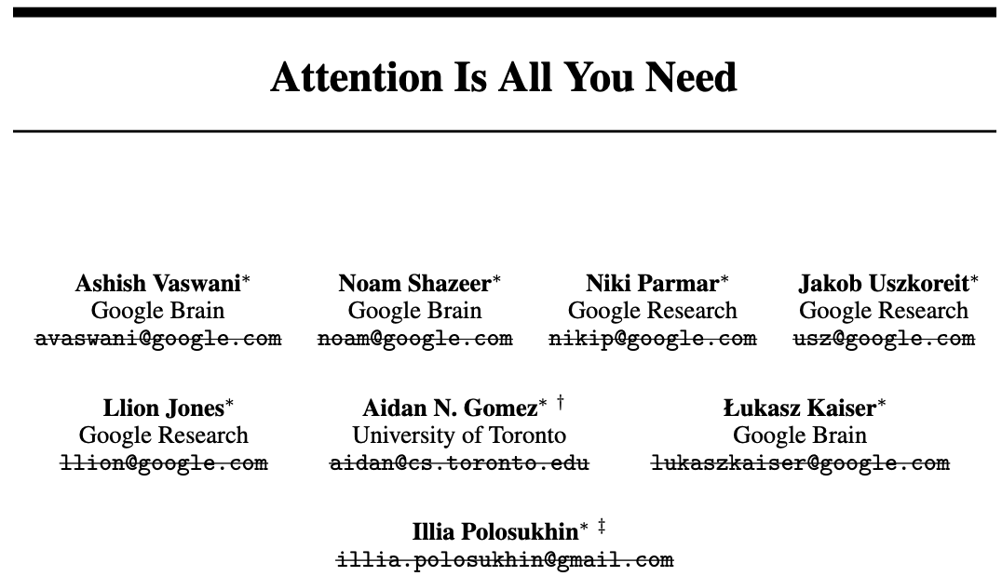
Essential AI
Anthropic
Inceptive
Cohere
Sakana AI
OpenAI
NEAR
https://arxiv.org/abs/1706.03762v6

Slide 12
Vanilla Transformers
The vanilla transformers (Vaswani et al., 2017) are also an encoder-decoder model!
Self-attention exists in both the encoder and decoder parts.

Slide 13
Query (Q), Key (K), and Value (V)
h₁
Weighted sum
a₁
a₂
a₃
a₄
Q₁
K₁
V₁
Q₂
K₂
V₂
Q₃
K₃
V₃
Q₄
K₄
V₄
🎯
e₁
I
e₂
printed
e₃
Hello
e₄
world

Slide 14
The Concept of Query (Q), Key (K), and Value (V)
Vaswani, Ashish, et al. "Attention is all you need." Advances in neural information processing systems 30 (2017).
The self-attention proposed in Vaswani et al. 2017 is query-key-value attention (QKV attention).
What is query-key-value attention?
Notes:
https://stats.stackexchange.com/questions/421935/what-exactly-are-keys-queries-and-values-in-attention-mechanisms

Slide 15
The Concept of Query (Q), Key (K), and Value (V)
Vaswani, Ashish, et al. "Attention is all you need." Advances in neural information processing systems 30 (2017).
The self-attention proposed in Vaswani et al. 2017 is query-key-value attention (QKV attention).
What is query-key-value attention?
The whole process is analogous to a retrieval system.
We query the search engine (e.g., YouTube), which tries to map our query to the keys such as video title and video descriptions in its database, and then return some best matched videos (values).
Notes:
neural networks - What exactly are keys, queries, and values in attention mechanisms? - Cross Validated (stackexchange.com)

Slide 16
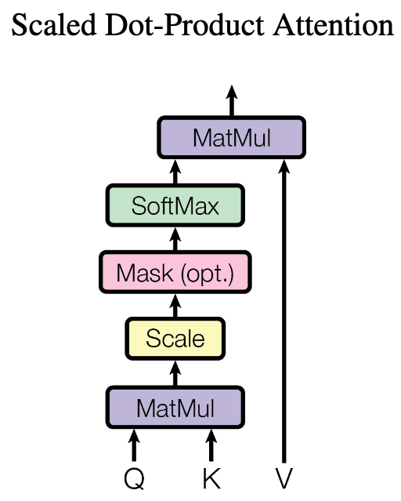
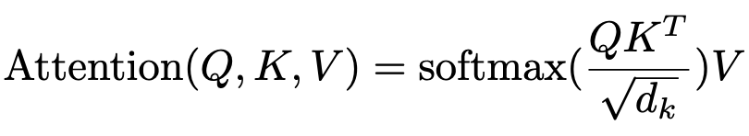
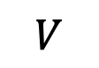
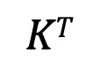
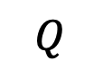
為什麼 Transformers 可以平行化？
d_{q} = d_{k} = d_{v}
(自注意力機制可以利用矩陣乘積來進行平行化計算)
$$Q$$
$$KT$$
$$V$$
Q₁
V₁
K₁
K₂
K₃
Q₂
V₂
Q₃
V₃
N x d_{k}
d_{k} x N
N x d_{k}
Q₁
K₁
V₁
Q₂
K₂
V₂
Q₃
K₃
V₃
e₁
I
e₂
printed
e₃
Hello

Slide 17
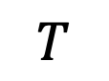
Transformers 的權重值 (1/2)
Q: N x d_{k}
K: N x d_{k}
V: N x d_{k}
(
)
$$T$$
e₁
e₁
e₁
e₂
W^{Q}
e₂
W^{K}
e₂
W^{V}
e₃
e₃
e₃
N x d_{model}
d_{model} x d_{k}
N x d_{model}
d_{model} x d_{k}
N x d_{model}
d_{model} x d_{k}
e₁
e₁
e₁
e₂
e₂
e₂
e₃
e₃
e₃
d_{model} : Embedding 的維度大小
I
printed
Hello

Slide 18
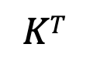
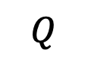
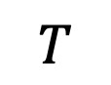
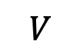
Transformers 的權重值 (2/2)
$$Q$$
$$KT$$
(
)
$$T$$
Q₁
e₁
e₁
K₁
K₂
K₃
=
W^{Q}
=
Q₂
e₂
e₂
W^{K}
Q₃
e₃
e₃
N x d_{k}
N x d_{model}
d_{model} x d_{k}
d_{k} x N
N x d_{model}
d_{model} x d_{k}
$$V$$
V₁
e₁
V₂
=
e₂
W^{V}
V₃
e₃
N x d_{k}
N x d_{model}
d_{model} x d_{k}

Slide 19
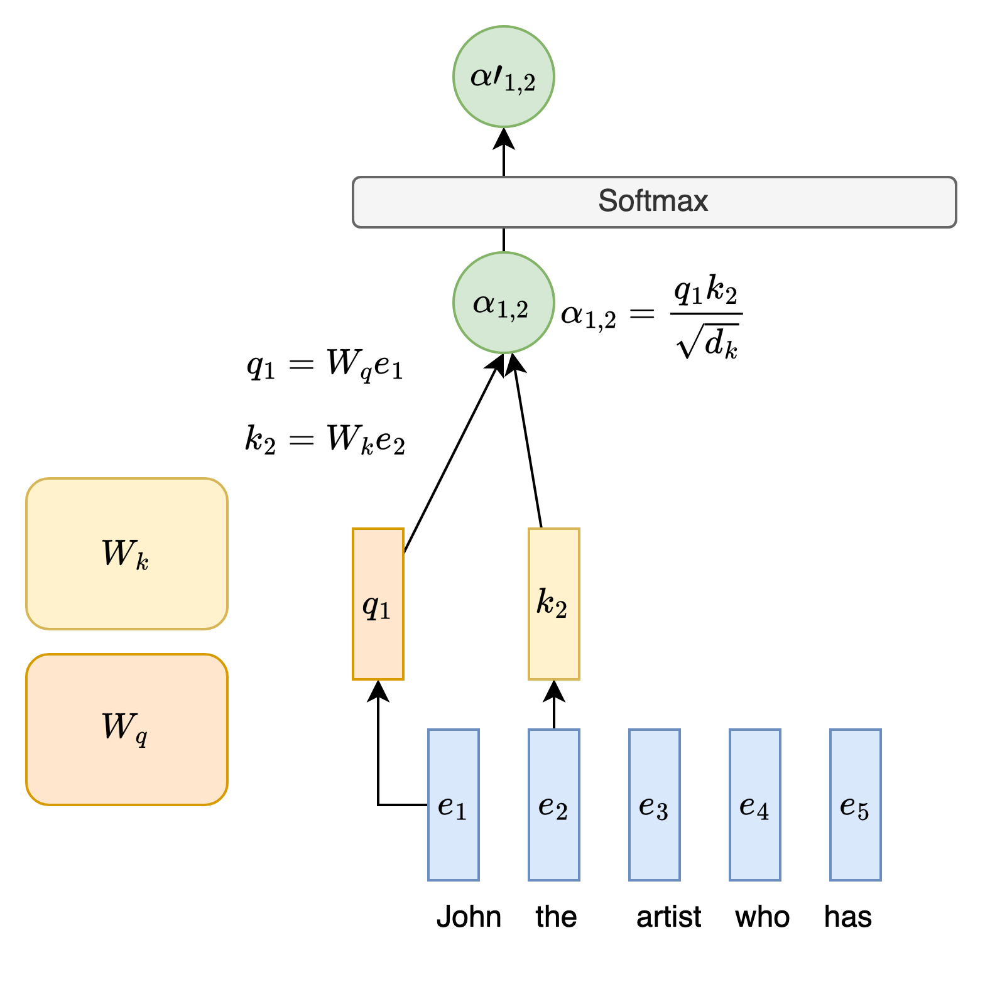
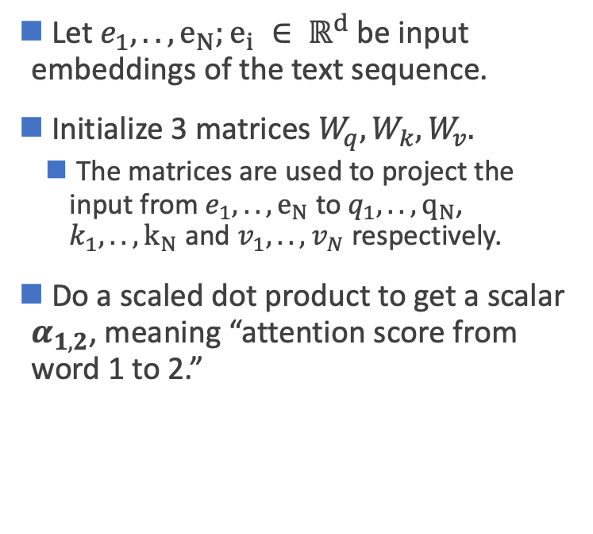
Self-Attention
Vaswani, Ashish, et al. "Attention is all you need." Advances in neural information processing systems 30 (2017).
Let $e_{1}, .., e_{N};e_{i} ∈ ℝ^{d}$ be input embeddings of the text sequence.
Initialize 3 matrices $W_{q}, W_{k}, W_{v}.$
The matrices are used to project the input from $e_{1}, .., e_{N}$ to $q_{1}, .., q_{N}$, $k_{1}, .., k_{N}$ and $v_{1}, .., v_{N}$ respectively.
Do a scaled dot product to get a scalar $α_{1,2}$, meaning “attention score from word 1 to 2.”
Notes:
neural networks - What exactly are keys, queries, and values in attention mechanisms? - Cross Validated (stackexchange.com)

Slide 20
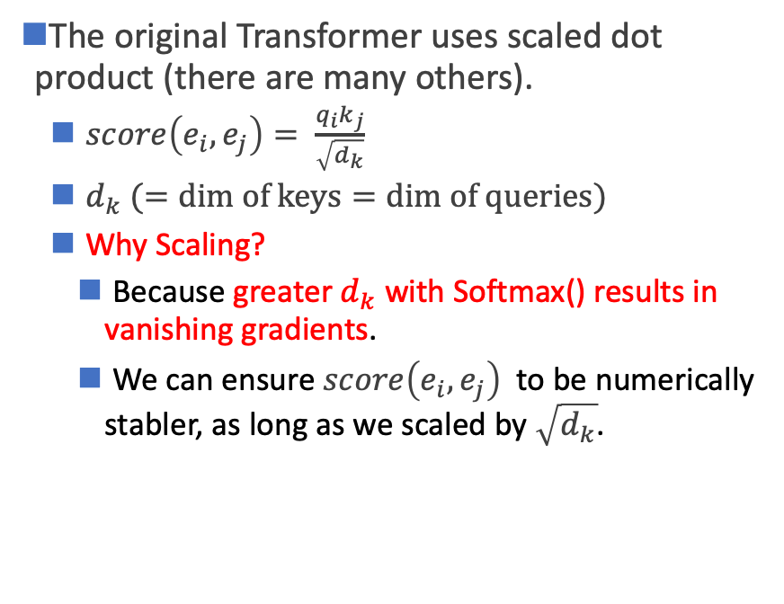
Attention Score
Vaswani, Ashish, et al. "Attention is all you need." Advances in neural information processing systems 30 (2017).
The original Transformer uses scaled dot product (there are many others).
$score\left(e_{i},e_{j}\right)= \frac{q_{i}k_{j}}{\sqrt{d_{k}}}$
$d_{k} (=dim of keys=dim of queries)$
Why Scaling?
Because greater $d_{k}$ with Softmax() results in vanishing gradients.
We can ensure $score\left(e_{i},e_{j}\right)$ to be numerically stabler, as long as we scaled by $\sqrt{d_{k}}$.
Notes:
neural networks - What exactly are keys, queries, and values in attention mechanisms? - Cross Validated (stackexchange.com)

Slide 21
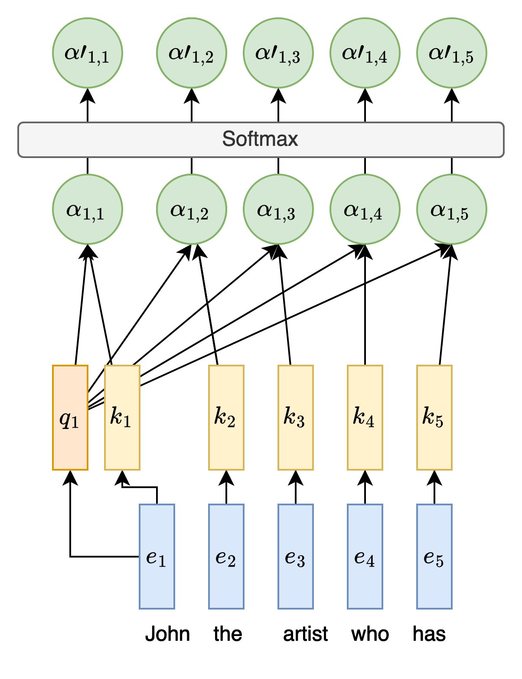
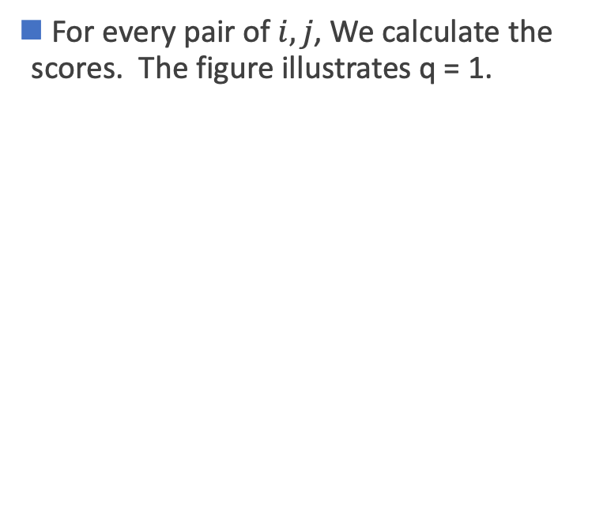
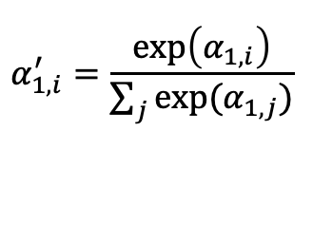
Attention Score
For every pair of $i,j$, We calculate the scores. The figure illustrates q = 1.
$$α_{1,i}^{′}=\frac{\exp\left(α_{1,i}\right)}{\sum_{j}{exp⁡(α_{1,j})}}$$
Notes:
neural networks - What exactly are keys, queries, and values in attention mechanisms? - Cross Validated (stackexchange.com)

Slide 22
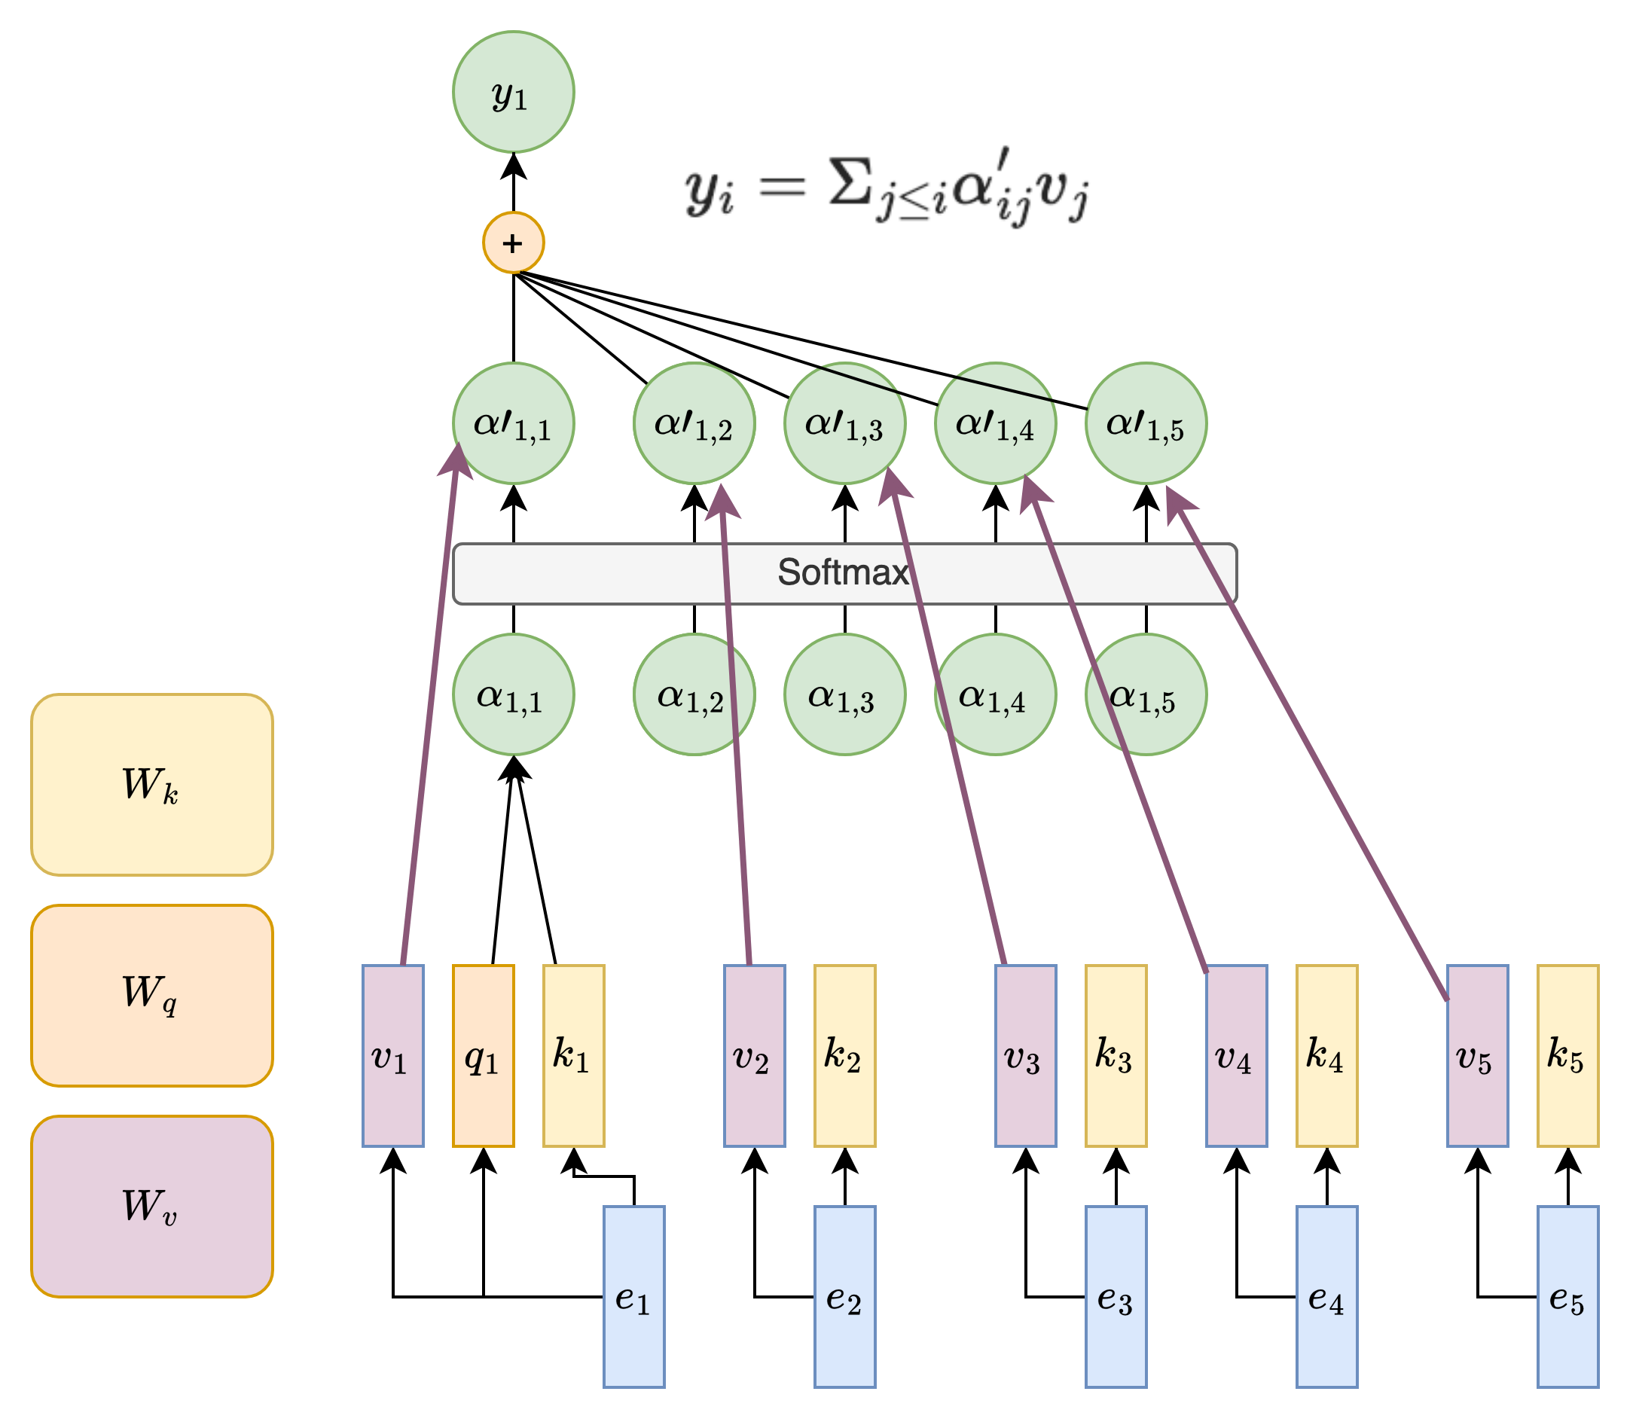
Self-Attention
The figure illustrates when q = 1.
The ➜ indicates scalar vector multiplication.

Slide 23
Multi-Head Attention (MHA)
In p. 12, we describe self-attention as QKV attention, where
we query the search engine
search engine tries to map our query to the keys
output some best matched videos (values)
What if we want to have queries focusing on different aspects?
For example, one set of queries focusing on semantic similarity, another set focusing on passive/active voice.
We need multiple attention mechanisms, i.e. multiple (attention) heads!

Slide 24





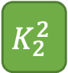








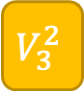

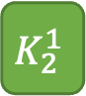

Multi-Head Attention (MHA)
上標: head
下標: token index
Head = 1 (without MHA)
Q₁
K₁
V₁
Q₂
K₂
V₂
Q₃
K₃
V₃
e₁
I
e₂
printed
e₃
Hello
Head = 2 (with MHA)
$$Q_{1}^{1}$$
$$Q_{1}^{2}$$
$$K_{1}^{1}$$
$$K_{1}^{2}$$
$$V_{1}^{1}$$
$$V_{1}^{2}$$
$$Q_{2}^{1}$$
$$Q_{2}^{2}$$
$$K_{2}^{1}$$
$$K_{2}^{2}$$
$$V_{2}^{1}$$
$$V_{2}^{2}$$
$$Q_{3}^{1}$$
$$Q_{3}^{2}$$
$$K_{3}^{1}$$
$$K_{3}^{2}$$
$$V_{3}^{1}$$
$$V_{3}^{2}$$
e₁
I
e₂
printed
e₃
Hello

Slide 25


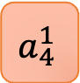

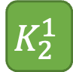

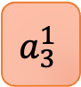
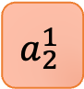



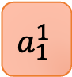
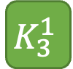




Query (Q), Key (K), and Value (V) with MHA
Head = 2, 使用第一個 head
$$h_{1}^{1}$$
Weighted sum
$$a_{1}^{1}$$
$$a_{2}^{1}$$
$$a_{3}^{1}$$
$$a_{4}^{1}$$
$$Q_{1}^{1}$$
$$K_{1}^{1}$$
$$V_{1}^{1}$$
$$Q_{2}^{1}$$
$$K_{2}^{1}$$
$$V_{2}^{1}$$
$$Q_{3}^{1}$$
$$K_{3}^{1}$$
$$V_{3}^{1}$$
$$Q_{4}^{1}$$
$$K_{4}^{1}$$
$$V_{4}^{1}$$
🎯
e₁
I
e₂
printed
e₃
Hello
e₄
world

Slide 26
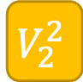
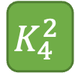
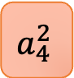

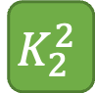

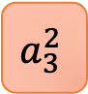
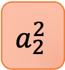



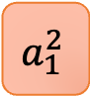
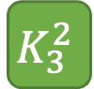

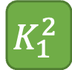

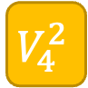
Query (Q), Key (K), and Value (V) with MHA
Head = 2, 使用第二個 head
$$h_{1}^{2}$$
Weighted sum
$$a_{1}^{2}$$
$$a_{2}^{2}$$
$$a_{3}^{2}$$
$$a_{4}^{2}$$
$$Q_{1}^{2}$$
$$K_{1}^{2}$$
$$V_{1}^{2}$$
$$Q_{2}^{2}$$
$$K_{2}^{2}$$
$$V_{2}^{2}$$
$$Q_{3}^{2}$$
$$K_{3}^{2}$$
$$V_{3}^{2}$$
$$Q_{4}^{2}$$
$$K_{4}^{2}$$
$$V_{4}^{2}$$
🎯
e₁
I
e₂
printed
e₃
Hello
e₄
world

Slide 27



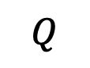





Input Dimensions of MHA
Head = 1 (without MHA)
$$Q$$
Q₁
e₁
=
W^{Q}
Q₂
e₂
Q₃
e₃
N x d_{k}
N x d_{model}
d_{model} x d_{k}
Head = 2 (with MHA)
d_{k} / 2
d_{k} / 2
d_{k} / 2
d_{k} / 2
$$Q_{1}^{1}$$
$$Q_{1}^{2}$$
e₁
$$Q_{2}^{1}$$
$$Q_{2}^{2}$$
=
e₂
$$W_{Q}^{1}$$
$$W_{Q}^{2}$$
$$Q_{3}^{1}$$
$$Q_{3}^{2}$$
e₃
N x d_{k}
N x d_{model}
d_{model} x d_{k}

Slide 28
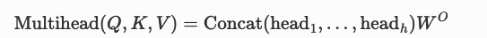
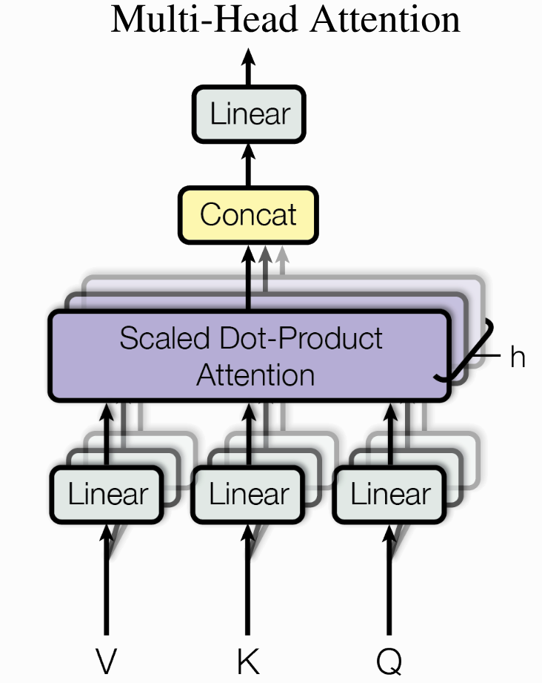
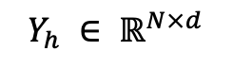

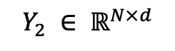
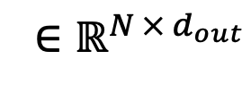

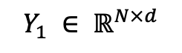



Output Dimensions
x
x
$$∈ ℝ^{N × (h ⋅d)}$$
$$∈ ℝ^{\left(h ⋅d\right) × d_{out}}$$
Head = 1 (without MHA)
h₁
h₁
$${ ∈ℝ}^{N × d_{out}}$$
X
W^{O}
=
$$∈ ℝ^{N × (h ⋅d)}$$
$$Y_{h} ∈ ℝ^{N×d}$$
...
Head = 2 (with MHA)
$$Y_{2} ∈ ℝ^{N×d}$$
$$Y_{1} ∈ ℝ^{N×d}$$
$$h_{1}^{1}$$
h₁
X
W^{O}
=
$$h_{1}^{2}$$

Slide 29

MHA 比較好嗎？
Clark, Kevin, et al. "What Does BERT Look at? An Analysis of BERT’s Attention." Proceedings of the 2019 ACL Workshop BlackboxNLP: Analyzing and Interpreting Neural Networks for NLP. 2019.
實驗證明：不同 head 關注的地方不太一樣
<layer>-<head number>
關注受詞
關注限定詞

Slide 30

Summary of MHA
With $W^{O}$, the concatenated head outputs can be projected to a preferred dimension (hyperparameter: $d_{out}$).
No worries on how #head changes dimension of outputs!
$${ ∈ℝ}^{N × d_{out}}$$
$$∈ ℝ^{N × (h ⋅d)}$$
$$Y_{h} ∈ ℝ^{N×d}$$
...
$$Y_{2} ∈ ℝ^{N×d}$$
$$Y_{1} ∈ ℝ^{N×d}$$

Slide 31

Transformer Encoder-Decoder
Decoder
Encoder
Vaswani, Ashish, et al. "Attention is all you need." Advances in neural information processing systems 30 (2017).

Slide 32

Self-Attention
Where is self-attention in Transformer?
Vaswani, Ashish, et al. "Attention is all you need." Advances in neural information processing systems 30 (2017).

Slide 33















Encoder and Decoder
Output hidden states
Output sequence
$${\hat{y}}_{1}$$
$${\hat{y}}_{2}$$
……
$${\hat{y}}_{t−1}$$
$${\hat{y}}_{t}$$
$$h_{0}$$
$$h_{1}$$
……
$$h_{n−2}$$
$$C$$
FFN
Encoder
Decoder
$$h_{init}$$
……
_
$${\hat{y}}_{1}$$
……
$${\hat{y}}_{t−2}$$
$${\hat{y}}_{t−1}$$
_
$$x1$$
$$x_{n−2}$$
$$x_{n−1}$$
(Start)
(Start)
Input sequence

Slide 34
Add & Norm
Add: Residual Connection
Norm: Layer Normalization
Vaswani, Ashish, et al. "Attention is all you need." Advances in neural information processing systems 30 (2017).

Slide 35



Add & Norm
Research shows that Residual Connection (He, Kaiming, et al., 2016) stabilizes training.
Let the layers in between learn the residual relationship (i.e. $Y−X$).
Standard
Residual
He, Kaiming, et al. "Deep residual learning for image recognition." Proceedings of the IEEE conference on computer vision and pattern recognition (2016).

Slide 36









Add & Norm
B: Batch Size
C: Channels / Embedding Feature Dimension
N: Sequence length
Layer Norm: For an input vector, calculate its mean and std across embedding dimension (within an example).
$norm\left(X\right)=\frac{X−μ}{σ}$
計算：$μ$ (平均數) & $σ$ (標準差)
$$x_{1}$$
$$h_{1}$$
$${h′}_{1}$$
...
...
...
$$x_{n}$$
$$h_{j}$$
$${h′}_{j}$$
(Batch Normalization)
Ba, Jimmy Lei, Jamie Ryan Kiros, and Geoffrey E. Hinton. "Layer normalization." arXiv preprint arXiv:1607.06450 (2016).

Slide 37





Add & Norm
$$\frac{{h′}_{1}−μ}{σ}$$
$$\frac{{h′}_{2}−μ}{σ}$$
$$\frac{{h′}_{3}−μ}{σ}$$
$$\frac{{h′}_{4}−μ}{σ}$$
h₁
h₂
h₃
h₄
計算：$μ$ (平均數) & $σ$ (標準差)
a₁
a₂
a₃
a₄
Q₁
K₁
V₁
Q₂
K₂
V₂
Q₃
K₃
V₃
Q₄
K₄
V₄
e₁
I
e₂
printed
e₃
Hello
e₄
world
Ba, Jimmy Lei, Jamie Ryan Kiros, and Geoffrey E. Hinton. "Layer normalization." arXiv preprint arXiv:1607.06450 (2016).

Slide 38

Why LN not BN?
資料長度差距
模型實作表現差異

Slide 39


Lack of Position Modeling
RNN processes sequences step-by-step.
However, in Transformers, we have no way to know the relative distance of one word to another!
The same word, eg. “Amy”, in the 2 sentences are encoded to the same $y ($with the same weight matrices).
Problematic because these 2 sentences convey different meanings, but same words are encoded identically!
Notes:
RNNs use the recurrent nature to encode relative distance, but self-attention alone does not have the concept of distance.
Figure link: https://www.google.com/imgres?imgurl=https%3A%2F%2Fen.pimg.jp%2F062%2F372%2F497%2F1%2F62372497.jpg&tbnid=h12XO59LOC-2AM&vet=12ahUKEwi-hZz5-aeEAxUjiq8BHWxaD30QMygLegQIARBw..i&imgrefurl=https%3A%2F%2Fwww.pixtastock.com%2Fillustration%2F62372497&docid=EjyqzObtASteNM&w=450&h=468&q=trouble%20face%20cute%20&ved=2ahUKEwi-hZz5-aeEAxUjiq8BHWxaD30QMygLegQIARBw

Slide 40
Positional Encoding
Where is the Positional Encoding inside the transformer?
In brief, it is a way to tell the model the position of each token in a sequence.
Vaswani, Ashish, et al. "Attention is all you need." Advances in neural information processing systems 30 (2017).
Notes:
RNNs use the recurrent nature to encode relative distance, but self-attention alone does not have the concept of distance.
Inside the transformer, the tokens in Inputs are encoded as Input Embedding, and then simply add the positional encoding of their position.
Figure link: https://www.google.com/imgres?imgurl=https%3A%2F%2Fen.pimg.jp%2F062%2F372%2F497%2F1%2F62372497.jpg&tbnid=h12XO59LOC-2AM&vet=12ahUKEwi-hZz5-aeEAxUjiq8BHWxaD30QMygLegQIARBw..i&imgrefurl=https%3A%2F%2Fwww.pixtastock.com%2Fillustration%2F62372497&docid=EjyqzObtASteNM&w=450&h=468&q=trouble%20face%20cute%20&ved=2ahUKEwi-hZz5-aeEAxUjiq8BHWxaD30QMygLegQIARBw

Slide 41

Positional Encoding Equations
創造出相對位置的 embeddings
核心精神：利用三角函數的週期性來建構序列資訊
偶數的 embedding 單元 (2i , i = 0, 1, …, d_{model})：Sin 函數
奇數的 embedding 單元 (2i+1, i = 0, 1, …, d_{model})： Cosine 函數
輸入序列中任一token的位置
Figure source: https://nlp.seas.harvard.edu/annotated-transformer/#positional-encoding

Slide 42

Positional Encoding Visualization
Question: 為什麼需要同時有 Sin 和 Cosine 的函數？
Ans: 藉由不同週期性來捕捉序列中各個位置的關係
Figure source: https://nlp.seas.harvard.edu/annotated-transformer/#positional-encoding

Slide 43
Feed Forward Networks
Simply multiply by a weight matrix.
Used to project to a specific dimension.
Vaswani, Ashish, et al. "Attention is all you need." Advances in neural information processing systems 30 (2017).

Slide 44

Decoder: Cross-Attention
K, V uses the output from encoder as their X;
Q uses the decoder’s information as X.
This is
Notes:
K, V uses the output from encoder as their X;
Q uses the decoder’s information as X.

Slide 45


Number of Layers
Vaswani, Ashish, et al. "Attention is all you need." Advances in neural information processing systems 30 (2017).
o$utput ∈ ℝ^{N × d }$
Input, output dimension match!
We can have multiple encoders stacked up, to increase the number of trainable parameters.
N *
input$∈ ℝ^{N × d }$

Slide 46

Transformers’ Achievements
1. In original paper, State-of-The-Art (SoTA) of machine translation.
6 encoders,
6 decoders,
h = 512, 100K train steps.
6 encoders,
6 decoders,
h = 1024, 300K train steps.
Vaswani, Ashish, et al. "Attention is all you need." Advances in neural information processing systems 30 (2017).
https://arxiv.org/abs/1706.03762

Slide 47
Transformer Variants (there are many more)
Universal Transformer
Adds Adaptive Computation Time
Dehghani, Mostafa, et al. "Universal transformers." arXiv preprint arXiv:1807.03819 (2018).
Longformer
Tackles long documents
Iz Beltagy, et al. (2020). Longformer: The Long-Document Transformer. arXiv:2004.05150.
Roformer
Changes the design of positional encoding
Su, Jianlin, et al. "RoFormer: Enhanced Transformer with Rotary Position Embedding. CoRR abs/2104.09864 (2021)." arXiv preprint arXiv:2104.09864 (2021).
Vision Transformer
Tackles vision tasks
Alexey Dosovitskiy, et al. “An Image is Worth 16x16 Words: Transformers for Image Recognition at Scale.” International Conference on Learning Representations. 2021.

Slide 48
Transformer能不能用在影像上呢？
Vision Transformer (ViT)

Slide 49

Concept: 把影像區域當成 token 輸入

Slide 50

Vision Transformer (ViT)
Class
Bird
Ball
Car
...
MLP Head
Transformer Encoder
* Extra learnable
class embedding
Patch + Position
Embedding
*
Linear Projection of Flattened Patches
16
16

Slide 51
Linear Projection of Flattened Patches
假設原始輸入是 224*224 的影像，切成 16*16 的小張影像 (patch)
每張 patch 進行 flattening 後，數值總數：16 * 16 * num_channels
使用線性轉換層將影像原始資料處理為 image embeddings
輸出的維度為 D，Linear Projection 的矩陣大小為 16 * 16 * num_channels * D
Linear Projection of Flattened Patches
16
16

Slide 52

Positional Embedding in ViT
假設原始輸入是 224*224 的影像，切成 16*16 的 patches
num_patches = 14 * 14 = 196，等同於有 196+1 (CLS) 個 embeddings
每個 patch 各自的 embedding (維度為D) 會在訓練過程中自動更新
…
* Extra learnable
class embedding
Patch + Position
Embedding
*
Linear Projection of Flattened Patches
16
16

Slide 53

Transformer Layer (Self-attention)
Left: ViT Transformer layer
Right: 原始 Transformers
使用 Post-norm!
使用 Pre-norm!

Slide 54

Why using Pre-Norm (Pre-Normalization)?
Xiong, Ruibin, et al. "On layer normalization in the transformer architecture." International conference on machine learning. 2020.

Slide 55
Additional Links
https://nlp.seas.harvard.edu/annotated-transformer/
https://datascience.stackexchange.com/questions/82451/why-is-10000-used-as-the-denominator-in-positional-encodings-in-the-transformer

Slide 56
Announcements

Slide 57
Week 9: Mid-term Exam
08: 50 – 10:20; 10:30 – 12:00 Mid-term Exam
分成兩梯次進行，使用電腦作答，本週三前公布梯次與座位表
題目 (範圍：W1 - W8 PPT 與 code)：
簡答題
程式題 (PyTorch 語法、訓練/測試框架)
可以搜尋 PyTorch 文件 (https://pytorch.org/docs/stable/index.html)
不能 Google、不能使用 LLMs

Slide 58
Thank you!
Instructor: 林英嘉
✉️ yjlin@cgu.edu.tw
TA: 林君襄
✉️ becky890926@gmail.com

